Slide 1

Minor Project Report
On “AI FIANACIAL ADVISOR"
Submitted by:
Hitesh Sangwan (Roll No: 2401730218)
Ankush Sangwan (Roll No: 2401730201)
Under the Guidance of: Mr. Vishwanil Suman

Slide 2
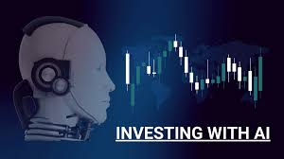
AIFA Report Overview
The AI Financial Advisor report explores the development, implementation, and impact of an artificial intelligence-driven financial advisory system. The project combines machine learning (ML) algorithms with web-based financial tools to provide personalized investment advice, risk assessment, and portfolio management.

Slide 3
Project Overview and Core Objectives
2. Core Objectives
A. Research & AI Development
Objective | Description
Develop AI-driven financial models | Use ML algorithms (neural networks, reinforcement learning) to predict market trends and optimize portfolios.
Improve accuracy over traditional advisors | Benchmark AI performance against human financial experts using historical data.
Ensure ethical & transparent AI | Address biases, provide explainable AI (XAI) insights, and comply with financial regulations.

Slide 4
Technology Stack
AI-driven financial advisory system
Web (React.js) & Mobile (React Native) apps
Python/Node.js backend with microservices
ML models: LSTM, XGBoost, Reinforcement Learning
PostgreSQL + MongoDB databases
Real-time data via WebSockets

Slide 5
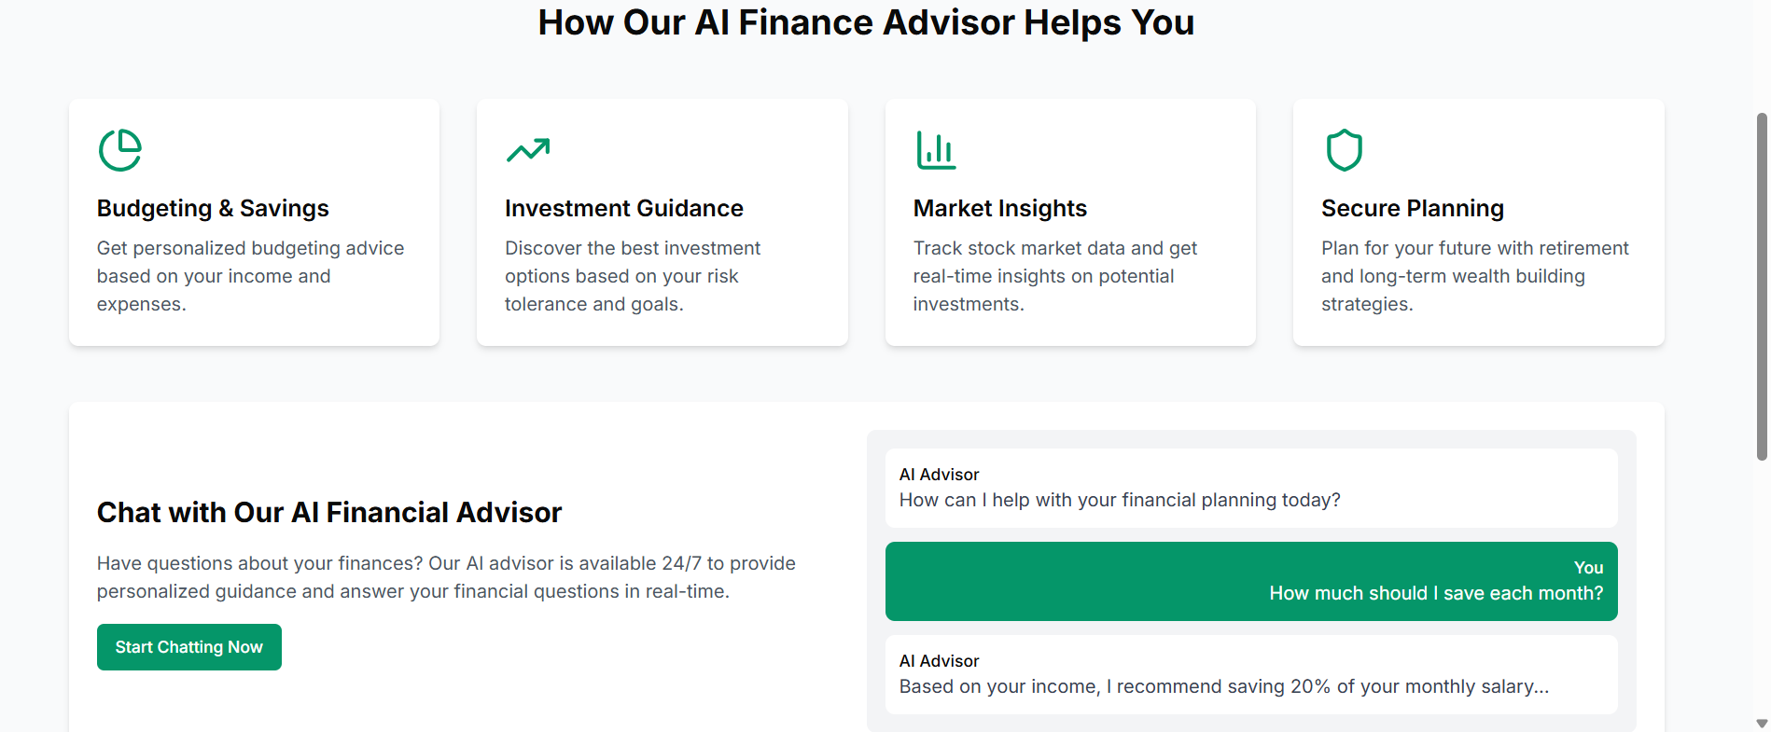
Key Features and Workflow

Slide 6
Project Outcome and Technical Learnings
Project Outcome:
Developed AI-powered financial advisory platform
Achieved a prediction accuracy in portfolio optimization
Enabled real-time decision-making for retail investors
Technical Learnings:
Reinforcement learning excels in dynamic markets
Feature engineering critical for model performance
Microservices improved scalability
Real-time data pipelines challenging but valuable

Slide 7
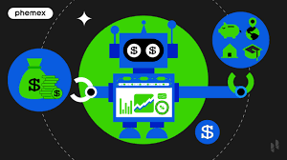
Summary and Future Directions
SUMMARY:
"AI-driven financial platform providing real-time investment recommendations and risk analysis through advanced algorithms and secure cloud infrastructure."
Future Direction:
Expand to cryptocurrency markets
Integrate voice-enabled AI assistant
Enhance predictive models with quantum computing
Develop blockchain-based transaction security
Partner with neo-banks for wider adoption

